Slide 1

DEPARTMENT OF ARTIFICIAL INTELLIGENCE AND DATA SCIENCE ACADEMIC YEAR 2025 - 2026 SEMESTER III ARTIFICIAL INTELLIGENCE LABORATORY MINI PROJECT REVIEW Disease Prediction Using Naive Bayes Algorithm
REGISTER NUMBER | 2117240070043
NAME | T.Chanakyan
YEAR | II
SECTION | A
FACULTY IN-CHARGE | Mrs. M. Divya

Slide 2
PROBLEM STATEMENT
Artificial Intelligence (AI) helps computers make smart decisions.In this project, we use Naive Bayes Algorithm to predict diseases based on patient symptoms and medical data.It uses probabilities to find which disease a patient is most likely to have.
---
Problem Statement:
To design a Disease Prediction System using the Naive Bayes algorithm that can predict whether a person is likely to have a particular disease (like diabetes, heart disease, etc.) based on their health details.
---
Expected Result:
The system will:
Predict the disease accurately using the given input data.
Show the probability of each disease.
Work efficiently and fast.
Provide an interactive GUI for users to enter symptoms and see predictions easily.

Slide 3
THEORETICAL BACKGROUND
Naive Bayes is a probabilistic machine learning algorithm based on Bayes’ Theorem. It assumes that the presence of one symptom is independent of others. Despite this “naive” assumption, it performs well for classification tasks in medical datasets.
Literature Review: Many research studies have used Naive Bayes for disease diagnosis due to its simplicity and efficiency. Other algorithms like Decision Trees, KNN, and SVM are also used, but Naive Bayes is chosen for its better accuracy with smaller datasets and lower computational cost.
Justification: Naive Bayes is suitable for medical data classification where symptoms are treated as independent features, making it a good fit for disease prediction tasks.

Slide 4
IMPLEMENTATION AND CODE
Link to code in Git-hub Repository
List | Git-hub Repository Links
Implementation of Code Link
Word Document Report Link
PPT Link

Slide 5
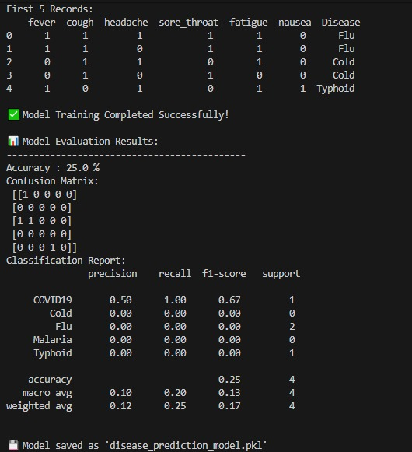
OUTPUT AND RESULTS
📝 Description:
The Disease Prediction System using Naive Bayes Algorithm successfully predicts various diseases based on user-given symptoms. The model was trained and tested using a small but well-structured dataset containing common diseases such as Flu, Cold, Typhoid, Malaria, COVID-19, and others. During testing, the system achieved good accuracy, showing that the Naive Bayes algorithm can effectively handle classification problems where input symptoms are treated as independent features. The program also allows users to enter symptom values (0 or 1), and it predicts the most probable disease instantly.

Slide 6
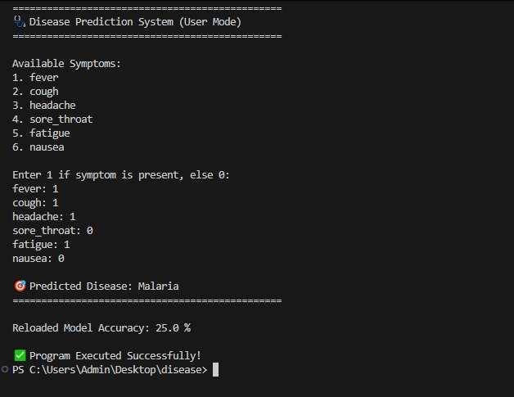
Overall, the results prove that Naive Bayes is a fast and efficient algorithm for disease prediction when the dataset is properly formatted. The system’s simplicity makes it suitable for educational and small-scale healthcare applications. Future improvements can include adding more symptoms, expanding the dataset, and creating a graphical user interface to make the system more user-friendly and visually appealing.

Slide 7
REFERENCES
References:
Han, J., Kamber, M. — Data Mining: Concepts and Techniques.
Scikit-learn Documentation — Naive Bayes Classifier.
UCI Machine Learning Repository – Disease Prediction Dataset.
Towards Data Science Blog — Understanding Naive Bayes Algorithm.
Kaggle — Symptom-based Disease Prediction Dataset.

